Slide 1
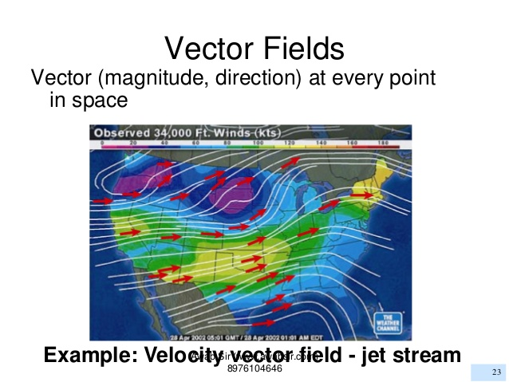

Slide 2
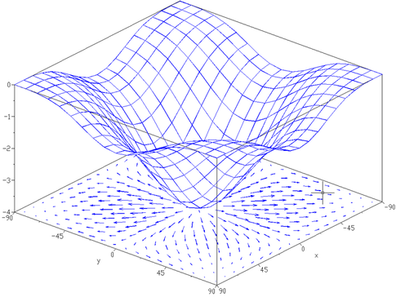
The Gradient Vector of a Function f(x,y) Describing a 3D-Surface

Slide 3
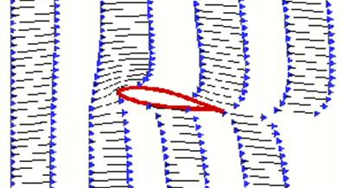
Airfoil and Lift. Air Velocity Field

Slide 4
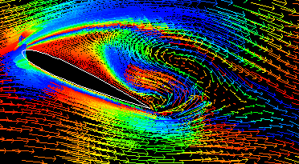
Velocity Field Around an Airfoil

Slide 5
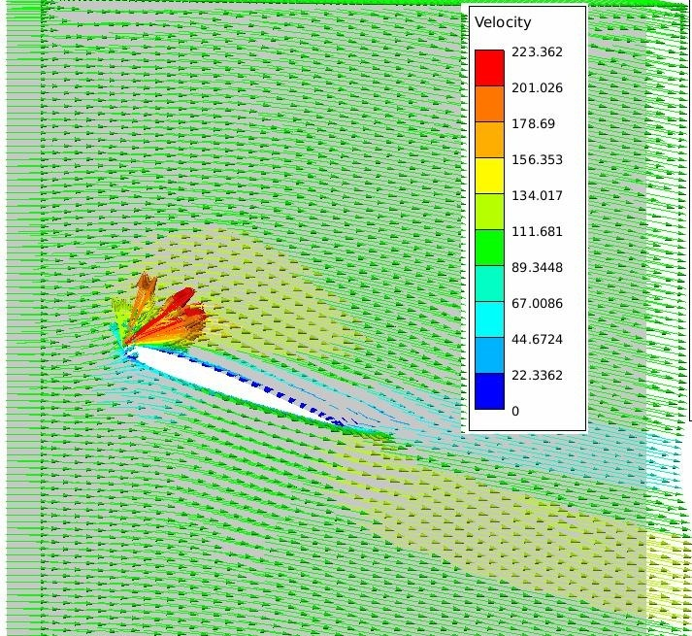
Velocity Field Around an Airfoil
Acceleration of the Air Above Wing

Slide 6
